Slide 1
Bayesian Network

Slide 2
Deterministic to Non Deterministic world
We used only two modalities for truth value in FOL.
True and False
Cavity => ToothAche may be true or false
DentalCatch => ToothAche may be true or false
In probabilistic reasoning we assign numeric value from a continuous domain [0,1]
P( Cavity => ToothAche = true ) = 0.85
P(DentalCatch => ToothAche = true ) = 0.35

Slide 3
Kolmogorov’s Axioms
All propositions are assigned values between 0 and 1
– 0<= P(a) <=1
True or False propositions
Valid Propositions have P(a) = 1
Invalid Propositions have P(a) = 0
The probability of a disjunction is given by
P(a V b) = P(a) + P(b) – P(a ^ b)

Slide 4
Derived Axioms
P(~a) = 1-P(a)
∑^{𝑛} 𝑃(𝐷 = d_{i}) = 1
𝑖
where D is a domain variable and d_{i} is the set of all possible discrete values of D.

Slide 5
Derived Axioms
Given P(DentalCatch => ToothAche = true ) - 0.35
P(~a) = 1-P(a)
P(DentalCatch => ToothAche = false) - 0.65
From axiom ∑^{𝑛} 𝑃(𝐷 = d_{i}) = 1
P(DentalCatch => ToothAche = false ) +
P( DentalCatch => ToothAche = true) = 1

Slide 6
Joint Probability & Conditional Probability
P(a) ^ P(b) ^ P(c) = P(a,b,c)
P(a => b) = P(b|a)

Slide 7
Joint Distribution
 | toothache |  | ~toothache
 | Catch | ~Catch | Catch | ~Catch
Cavity | 0.108 | 0.012 | 0.072 | 0.008
~Cavity | 0.016 | 0.064 | 0.144 | 0.576
Sum of all the
values = 1

Slide 8
Queries on Joint Distribution
 | toothache |  | ~toothache
 | Catch | ~Catch | Catch | ~Catch
Cavity | 0.108 | 0.012 | 0.072 | 0.008
~Cavity | 0.016 | 0.064 | 0.144 | 0.576
 | toothache |  | ~toothache
 | Catch | ~Catch | Catch | ~Catch
Cavity | 0.108 | 0.012 | 0.072 | 0.008
~Cavity | 0.016 | 0.064 | 0.144 | 0.576
P(Cavity) = ?
P(Cavity) = 0.2

Slide 9
Queries on Joint Distribution
 | toothache |  | ~toothache
 | Catch | ~Catch | Catch | ~Catch
Cavity | 0.108 | 0.012 | 0.072 | 0.008
~Cavity | 0.016 | 0.064 | 0.144 | 0.576
 | toothache |  | ~toothache
 | Catch | ~Catch | Catch | ~Catch
Cavity | 0.108 | 0.012 | 0.072 | 0.008
~Cavity | 0.016 | 0.064 | 0.144 | 0.576
P(Cavity V toothache) = ?
P(Cavity) = 0.28

Slide 10
Queries on Joint Distribution
 | toothache |  | ~toothache
 | Catch | ~Catch | Catch | ~Catch
Cavity | 0.108 | 0.012 | 0.072 | 0.008
~Cavity | 0.016 | 0.064 | 0.144 | 0.576
P(Cavity V tooth ache) = 0.28
Marginalization or summing out -
Marginalizing the probability of a proposition by summing up the probabilities of their co-occurrence with other propositions.

Slide 11

Baye’s Rule
P(a ^ b) = P(a|b) P(b)
P(a ^ b) = P(b|a) P(a)
P(Cavity|toothache) = P(cavity ^toothache) / P(toothache)
P(Y) = ∑^{𝑛} 𝑃(𝑌|𝑍) P(z)
𝑖

Slide 12
Queries on Joint Distribution
 | toothache |  | ~toothache
 | Catch | ~Catch | Catch | ~Catch
Cavity | 0.108 | 0.012 | 0.072 | 0.008
~Cavity | 0.016 | 0.064 | 0.144 | 0.576
 | toothache |  | ~toothache
 | Catch | ~Catch | Catch | ~Catch
Cavity | 0.108 | 0.012 | 0.072 | 0.008
~Cavity | 0.016 | 0.064 | 0.144 | 0.576
P(Cavity ^ toothache) = ?
P(Cavity ^ toothache) = 0.108 + 0.012

Slide 13
Queries on Joint Distribution
 | toothache |  | ~toothache
 | Catch | ~Catch | Catch | ~Catch
Cavity | 0.108 | 0.012 | 0.072 | 0.008
~Cavity | 0.016 | 0.064 | 0.144 | 0.576
P(toothache) = ?
P(toothache) = 0.108 + 0.012 + 0.016 + 0.064
P(Cavity|toothache) = P(cavity ^ toothache) / P(toothache)

Slide 14
Bayesian Network
Conditional probabilities are combined to form a Bayesian network
A set of random variables
A set of directed links
Each node represents the conditional probability, P(X|Parents(X))
The graph has no directed cycles

Slide 15
Sample Network
P(B)
0.001
P(E)
0.002
Fire
Burglary
B | F | P(A)
T | T | .95
T | F | .94
F | T | .29
F | F | .001
Alarm
P2 Calls
P1 calls
P1 | P(J)
t | .95
f | .05
P2 | P(J)
t | .80
f | .01

Slide 16
P ( P1, P2, A, ~B, ~E) = ?
Burglary = False, Earthquake = False
Alarm = True | Burglary = False, Earthquake = False
Person 2 calls | Alarm = True | Burglary = False, Earthquake = False
Person 1 calls | Alarm = True | Burglary = False, Earthquake = False
P (~B)
P (~E)
P (A | ~B,~E)
P (P2 | A)
P (P1 | A)
= P (P1|A) * P (P2|A) * P (A|~B~F) * P (~B) * P (~F)
= 0.95 * 0.80 * 0.001 * 0.999 * 0.998

Slide 17
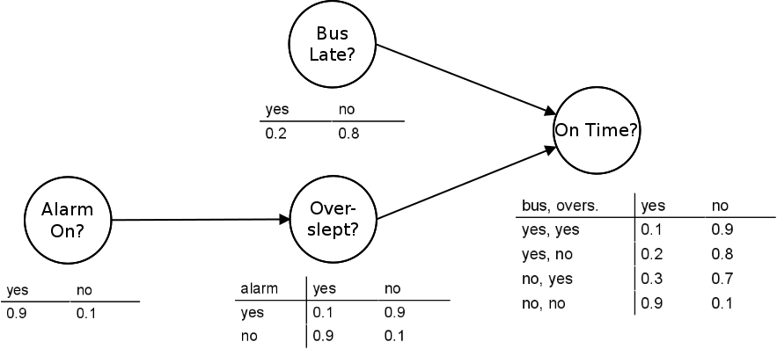

Slide 18
It’s the final league match, and everyone’s eyes are on Kishal, the star striker of his football team. Kishal has been training hard all week, and if his training sessions went well, he’s set to deliver a top performance.
But there’s a catch—he picked up a minor ankle injury in practice, which could affect his game. To make things trickier, the weather forecast says heavy rain, which usually slows him down on the wet pitch.
If Kishal plays well, he’ll create plenty of scoring chances for his team. But if his performance dips, the coach might substitute him before the final whistle.
Calculate the probability of winning the match while Kishal is injured and the weather predicts rain.

